Slide 1
Bayesian Computing
Class: Final Yr B.Tech.
Course Code: DJ19CEHN1C3
An adaptation of online resources for educational purpose

Slide 2
Unit 3: Markov Chain Monte Carlo Methods
An adaptation of online resources for educational purpose

Slide 3
What is Simulation?
Simulation is the imitation of the operation of real world process or system over time
Hypothesis viability
Effects of process change
Performance of planned system
Faster decision making
Simulation AI & ML
Generates more training and testing data
High quality ground truth
It does not produce an exact answer but in fact it is a statistical estimate with error

Slide 4
What is Monte Carlo Simulation?
Mathematical technique that predicts possible outcomes of an uncertain event
It uses a computer system to run enough simulations to produce different outcomes that mimic real-life results. The system uses random number generators to recreate the inherent uncertainty of the input parameters. Random number generators are computer programs that produce an unpredictable sequence of random numbers.
Simple implementation on computer
Applicable for complex problems
It does not produce an exact answer but in fact it is a statistical estimate with error

Slide 5
Why Monte Carlo Simulations?
Probabilistic model with an element of uncertainty or randomness
For example, the distance between your home and office is fixed.
However, a probabilistic simulation might predict different travel times by considering factors such as congestion, bad weather, and vehicle breakdowns.
Conventional forecasting methods are more deterministic
They provide a definite answer to the prediction and cannot factor in uncertainty. For instance, they might tell you the minimum and maximum travel time, but both answers are less accurate.

Slide 6
Benefits of Monte Carlo Simulations?
Large pool of random data samples
It offers a clearer picture than a deterministic forecast
For instance, forecasting financial risks requires analyzing dozens or hundreds of risk factors. Financial analysts use the Monte Carlo simulation to produce the probability of every possible outcome.

Slide 7
History of Monte Carlo Simulations?
John von Neumann and Stanislaw Ulam invented the Monte Carlo simulation, or the Monte Carlo method, in the 1940s.
They named it after the famous gambling location in Monaco because the method shares the same random characteristic as a roulette game.

Slide 8
What are the Monte Carlo simulation use cases?
Companies use Monte Carlo methods to assess risks and make accurate long-term predictions. The following are some examples of use cases.
Business
Business leaders use Monte Carlo methods to project realistic scenarios when making decisions. For example, a marketer needs to decide whether it's feasible to increase the advertising budget for an online yoga course. They could use the Monte Carlo mathematical model on uncertain factors or variables such as the following:
Subscription fee
Advertising cost
Sign-up rate
Retention
The simulation would then predict the impact of changes on these factors to indicate whether the decision is profitable.

Slide 9
What are the Monte Carlo simulation use cases?
Finance
Financial analysts often make long-term forecasts on stock prices and then advise their clients of appropriate strategies. While doing so, they must consider market factors that could cause drastic changes to the investment value. As a result, they use the Monte Carlo simulation to predict probable outcomes to support their strategies.
Online gaming
Strict regulations govern the online gaming and betting industry. Customers expect gaming software to be fair and mimic the characteristics of its physical counterpart. Therefore, game programmers use the Monte Carlo method to simulate results and ensure a fair-play experience.
Engineering
Engineers must ensure the reliability and robustness of every product and system they create before making it available to the public. They use Monte Carlo methods to simulate a product’s probable failure rate based on existing variables. For example, mechanical engineers use the Monte Carlo simulation to estimate the durability of an engine when it operates in various conditions.

Slide 10
A Business Planning Example using Monte-Carlo Simulation?
Imagine you are the marketing manager for a firm that is planning to introduce a new product. You need to estimate the first year net profit from this product, which will depend on:
Sales volume in units
Price per unit
Unit cost
Fixed costs
Net profit = Net Profit = Sales Volume* (Selling Price - Unit cost) - Fixed costs
Fixed costs (for overhead, advertising, etc.) are known to be $120,000.
But the other factors all involve some uncertainty.
Sales volume (in units) can cover quite a range, and the selling price per unit will depend on competitor actions.
Unit costs will also vary depending on vendor prices and production experience.

Slide 11
A Business Planning Example using Monte-Carlo Simulation?
Uncertain Variables
To build a risk analysis model, we must first identify the uncertain variables -- also called random variables. While there's some uncertainty in almost all variables in a business model, we want to focus on variables where the range of values is significant.

Slide 12
A Business Planning Example using Monte-Carlo Simulation?
Sales and Price
Based on your market research, you believe that there are equal chances that the market will be Slow, OK, or Hot.
In the "Slow market" scenario, you expect to sell 50,000 units at an average selling price of $11.00 per unit.
In the "OK market" scenario, you expect to sell 75,000 units, but you'll likely realize a lower average selling price of $10.00 per unit.
In the "Hot market" scenario, you expect to sell 100,000 units, but this will bring in competitors who will drive down the average selling price to $8.00 per unit.
As a result, you expect to sell 75,000 units (i.e., (50,000+75,000+100,000)/3 = 75,000) at an average selling price of $9.67 per unit (i.e., ($11+$10+$8)/3 = $9.67).

Slide 13
A Business Planning Example using Monte-Carlo Simulation?
Unit Cost
Another uncertain variable is Unit Cost. Your firm’s production manager advises you that unit costs may be anywhere from $5.50 to $7.50, with a most likely cost of $6.50. In this case, the most likely cost is also the average cost.
Uncertain Functions
Net Profit
Our next step is to identify uncertain functions -- also called functions of a random variable. Recall that Net Profit is calculated as Net Profit = Sales Volume * (Selling Price - Unit cost) - Fixed costs. However, Sales Volume, Selling Price and Unit Cost are all uncertain variables, so Net Profit is an uncertain function.

Slide 14
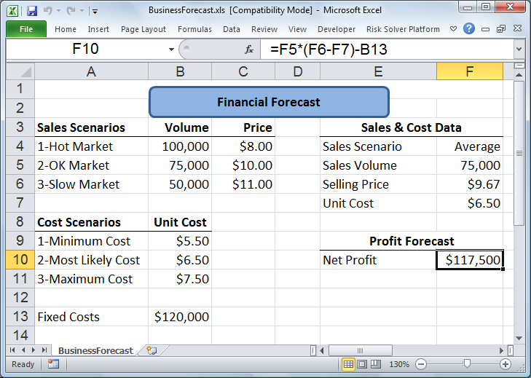
A Business Planning Example using Monte-Carlo Simulation?
The Flawed Average Model
Intuition-plugging the average value of our uncertain inputs (Sales Volume, Selling Price, and Unit Cost) into our model should produce the average value of the output (Net Profit).
However,
Net Profit figure of $117,750 calculated by this model, based on average values for the uncertain factors, is quite misleading.
The true average Net Profit is closer to $93,000!

Slide 15
How does the Monte-Carlo Simulation work?
Basic principle – ergodicity
The statistical behavior of a moving point in an enclosed system
This becomes the basis of the Monte Carlo simulation, in which the computer runs enough simulations to produce the eventual outcome of different inputs.
For example, a six-sided die has a one-sixth chance of landing on a specific number. When you roll the die six times, you might not land the die on six different numbers.
However, you will achieve the theoretical probability of one-sixth for each number when you continue indefinitely rolling.
The result accuracy is proportional to the number of simulations.
i.e. running 10,000 simulations produces more accurate results than 100 simulations.

Slide 16
The Monte Carlo simulation compared to machine learning?
Machine learning (ML) is a computer technology that uses a large sample of input and output (I/O) data to train software to understand the correlation between both.
A Monte Carlo simulation, on the other hand, uses samples of input data and a known mathematical model to predict probable outcomes occurring in a system. You use ML models to test and confirm the results in Monte Carlo simulations.

Slide 17
What are the components of a Monte Carlo simulation?
Input variables
Ex. For example, manufacturing quality and temperature are input variables that influence a smartphone's durability.
Output variables
For example, an electronic device’s life expectancy is an output variable, with its value being a time such as 6 months or 2 years.
Mathematical model
For example, the mathematical model for profitability is Profit = Revenue − Expenses.
The Monte Carlo software replaces revenue and expenses with probable values based on the probability distribution type. Then it repeats the simulation to get a highly accurate result. The Monte Carlo simulation can run for hours when the mathematical model involves many random variables.

Slide 18
What are probability distributions in the Monte Carlo simulation?
Probability distributions are statistical functions that represent a range of values distributed between limits.
Statistics experts use probability distributions to predict the possible occurrence of an uncertain variable, which might consist of discrete or continuous values.
Discrete probability distribution is represented by whole numbers or a sequence of finite numbers.
Each of the discrete values has a probability greater than zero.
Statisticians plot discrete probability distribution on a table, but they plot continuous probability distribution as a curve between two given points on the x-axis of a graph.

Slide 19
What are probability distributions in the Monte Carlo simulation?
The following are common types of probability distributions that a Monte Carlo simulation can model.
Normal distribution
known as the bell curve, is symmetrically shaped like a bell and represents most real-life events.
For example, a repeated random sampling of the weight of students in a particular classroom gives you a normal distribution chart.
Uniform distribution
statistical representation of random variables with equal chance.
For example, the uniform distribution represents the likelihood of rolling and landing on each side of a die.
Triangular distribution
uses minimum, maximum, and most-likely values to represent random variables.
upcoming sales volumes by establishing the triangle's minimum, maximum, and peak value.

Slide 20
What are the steps in performing the Monte Carlo simulation?
Monte Carlo method involves the following steps,
Establish the mathematical model
Determine the input values
Create a sample dataset
Set up the Monte Carlo simulation software
Analyze the results

Slide 21
What are the challenges of the Monte Carlo simulation?
These are two common challenges when using Monte Carlo simulations:
The Monte Carlo simulation is highly dependent on the input values and distribution. If mistakes are made when electing the input and probability distribution, it can lead to inaccurate results.
It might take excessive computational power to perform Monte Carlo experiments. Computing with the Monte Carlo method can take hours or days to complete on a single computer.

Slide 22
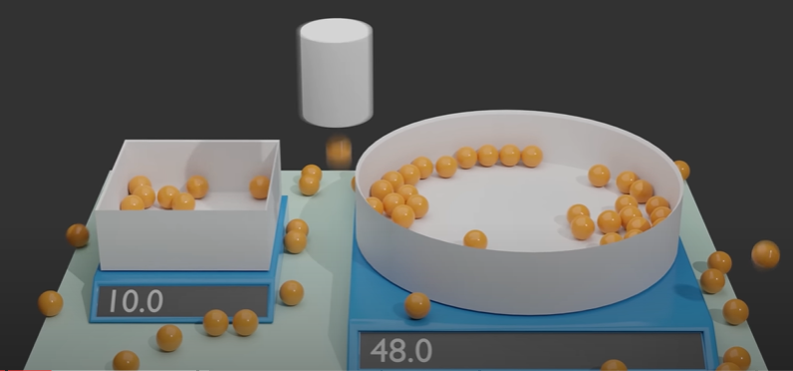
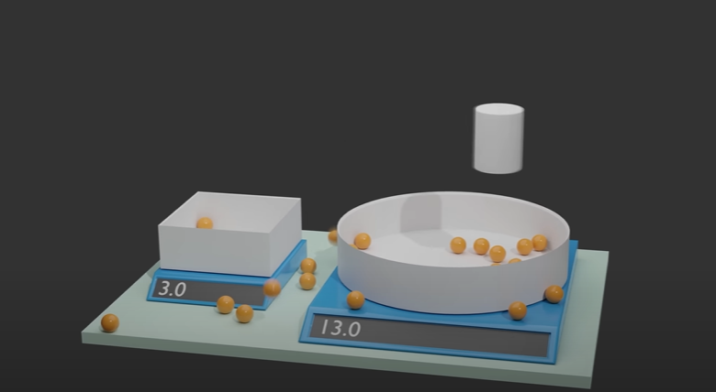
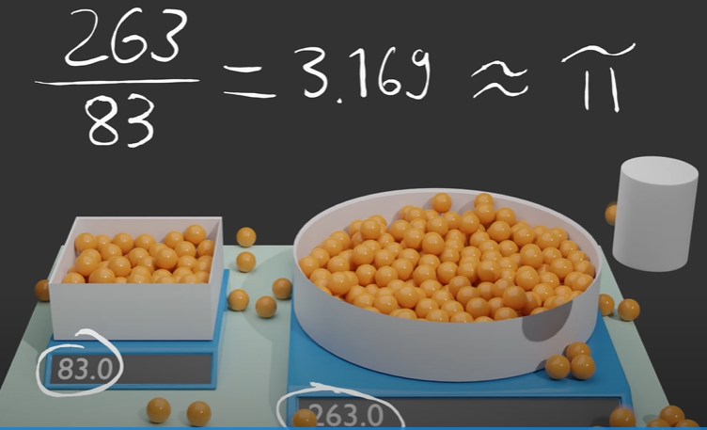
Monte Carlo simulation
Monte Carlo simulations:

Slide 23
What Is a Markov Chain?
These are two common challenges when using Monte Carlo simulations:

Slide 24
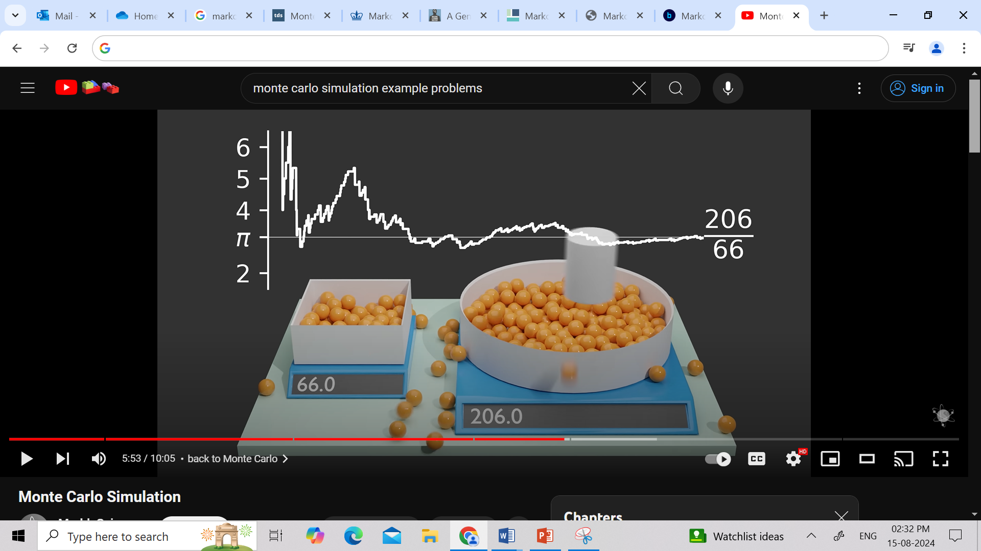
What Is a Markov Chain?
These are two common challenges when using Monte Carlo simulations:

Slide 25
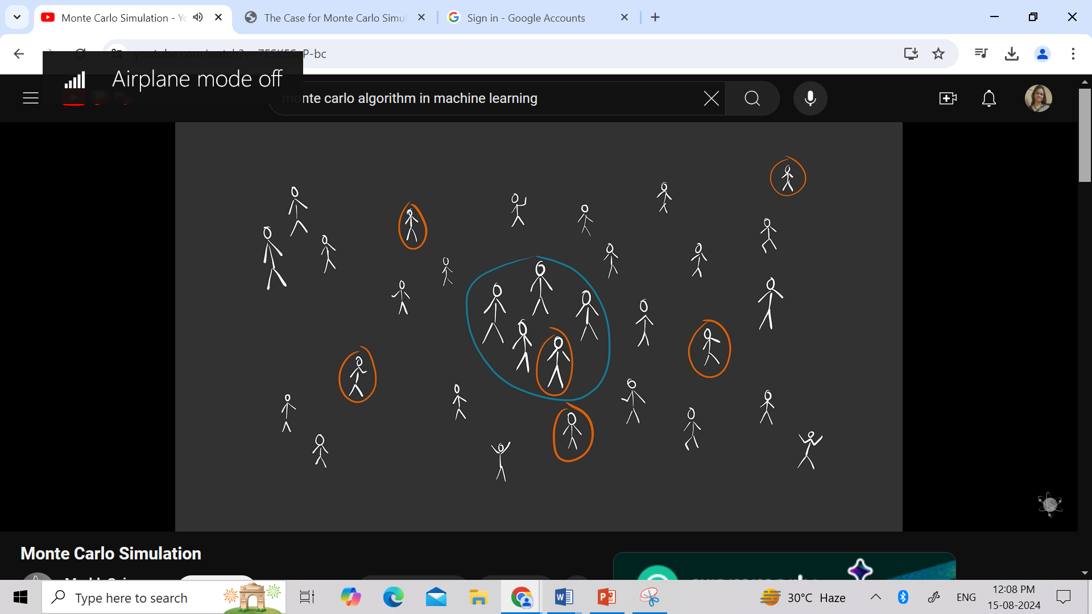
Monte Carlo simulation
Monte Carlo simulations:

Slide 26
Bayesian Analysis : Prior and Posterior Distribution
Our treatment of parameter estimation thus far has assumed that θ is an unknown but non-random quantity—it is some fixed parameter describing the true distribution of data, and our goal was to determine this parameter.
This is the called the frequentist paradigm of statistical inference.
In Bayesian paradigm, θ itself is modeled as a random variable.
The Bayesian paradigm naturally incorporates our prior belief about the unknown parameter θ, and updates this belief based on observed data.
Prior distribution: Before data is observed, the unknown parameter is modeled as a random variable Θ having a probability distribution fΘ(θ)
This distribution represents our prior belief about the value of this parameter.

Slide 27
Bayesian Analysis : Prior and Posterior Distribution
Posterior probability adds a layer to this by factoring in subsequent data and adjusting your prior belief accordingly – it’s effectively like taking another look with fresh eyes.
The posterior distribution describes the state of knowledge about θ after observing the data.
Given prior information combined with data from observations or experiments, the posterior summarizes all you know after factoring in that new evidence.
It provides estimates of parameters like intervals or points as well as predictions about future data outcomes through probabilistic evaluations to help inform decisions under uncertain conditions.

Slide 28
Bayesian Analysis : Prior and Posterior Distribution
The Probability Density Function(PDF) defines the probability function representing the density of a continuous random variable lying between a specific range of values.
It produces the likelihood of values of the continuous random variable.

Slide 29
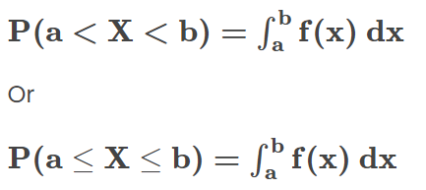
Bayesian Analysis : Prior and Posterior Distribution
For continuous random variable,
P(X = x)= 0
Calculate P(a< X< b), using PDF.
The Probability density function formula is given as,
For continuous X, ignore the endpoints of intervals while finding probabilities of continuous random variables.
That means, for any constants a and b,
P(a ≤ X ≤ b) = P(a < X ≤ b) = P(a ≤ X < b) = P(a < X < b).

Slide 30
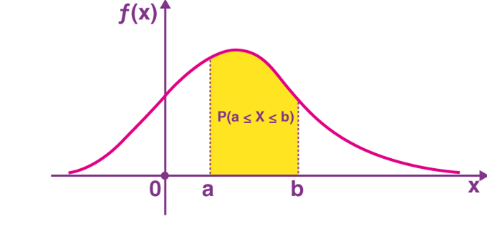
Bayesian Analysis : Prior and Posterior Distribution
The probability density function is defined as an integral of the density of the variable density over a given range.
It is denoted by f (x)

Slide 31
Bayesian Analysis : Prior and Posterior Distribution
The probability density function is defined as an integral of the density of the variable density over a given range.
It is denoted by f (x)

Slide 32

Bayesian Analysis : Computing Integrals
If we observe data y from a sampling density f(y|θ), where θ is a vector of parameters and one assigns θ a prior g(θ), then the posterior density of θ is proportional to
Computational problem
To summarize this multivariate probability distribution to perform inference about functions of θ.

Slide 33
Bayesian Analysis : Computing Integrals
The Bayesian recipe for inference is conceptually simple. If we observe data y from a sampling density f(y|θ), where θ is a vector of parameters and one assigns θ a prior g(θ), then the posterior density of θ is proportional to
Computational problem
To summarize this multivariate probability distribution to perform inference about functions of θ.

Slide 34

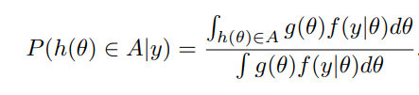
Bayesian Analysis : Computing Integrals
Many of the posterior summaries are expressible in terms of integrals.
Suppose we are interested in the posterior mean of a function h(θ).
This mean is expressible as a ratio of integrals
If we are interested in the posterior probability that h(θ) falls in a set A, we wish to compute

Slide 35


Monte Carlo Method for Computing Integrals
A second general approach for summarizing a posterior distribution is based on simulation.
Suppose that θ has a posterior density g(θ|y) and we are interested in learning about a particular function of the parameters h(θ).
The posterior mean of h(θ) is given by,
Suppose we are able to simulate an independent sample θ¹,...,θ^{m} from the posterior density.
Then the Monte Carlo estimate at the posterior mean is given by the sample mean

Slide 36

Discrete Markov Chains
A Markov chain is a stochastic process that evolves over time by transitioning into different states.
The sequence of states is denoted by the collection { X _{i} }
Transition between states is random, following the rule
Markov property
This relationship means that the probability distribution of the process at time ‘t’, given all of the previous values of the chain, is equal to the probability distribution given just the previous value
A Markov chain describes probabilistic movement between a number of states.
So in determining the sequence of values that the chain takes, we can determine the distribution of our next value given just our current value.

Slide 37
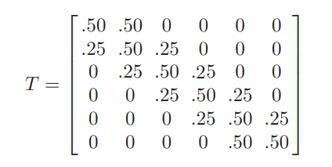
Discrete Markov Chains
Random walk - 1, 2, 3, 4, 5, 6
Interior value (2, 3, 4, or 5)
Next move - equally likely to remain at that number or move to an adjacent number
Next move…
Transition Matrix T:

Slide 38


Discrete Markov Chains
One’s current location - a probability row vector
where pi represents the probability the person is currently in state i. If pj represents the location of the traveler at step j, then the location of the traveler at the j + 1 step is given by the matrix product

Slide 39

Discrete Markov Chains Properties
Irreducible - It is possible to go from every state to every state in one or more steps
Periodic - Given that the person is in a particular state, if the person can only return to this state at regular intervals
Stationary state – If a Markov chain is irreducible and aperiodic, then it has a unique stationary distribution
Probability vector w, such that
Then w is said to be the stationary distribution

Slide 40
Markov Chain Monte Carlo Methods
Simulating from a general posterior distribution
A continuous-valued generalization of the discrete Markov chain
The MCMC sampling strategy sets up an irreducible, aperiodic Markov chain for which the stationary distribution equals the posterior distribution of interest.

Slide 41
Metropolis-Hasting Algorithms
General way of constructing a Markov chain

